Slide 1
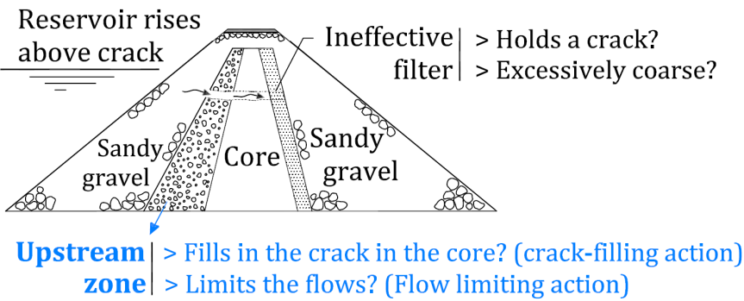
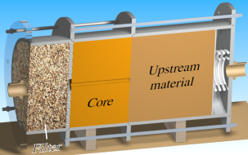
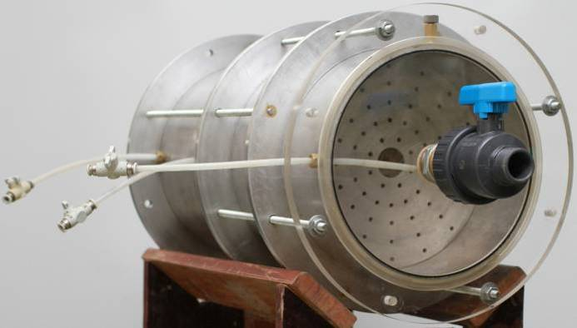
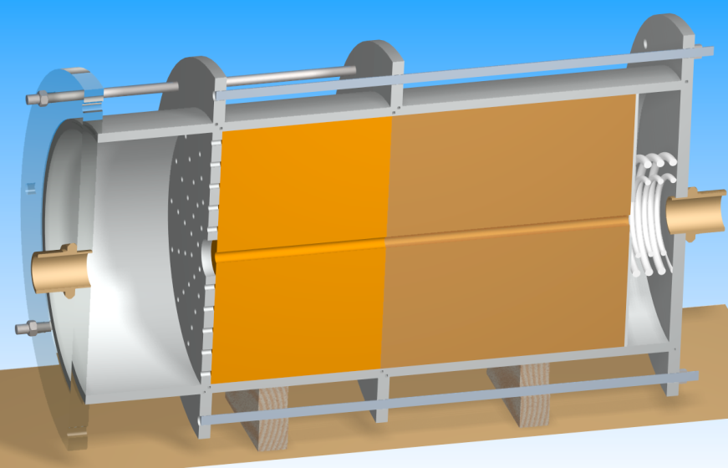
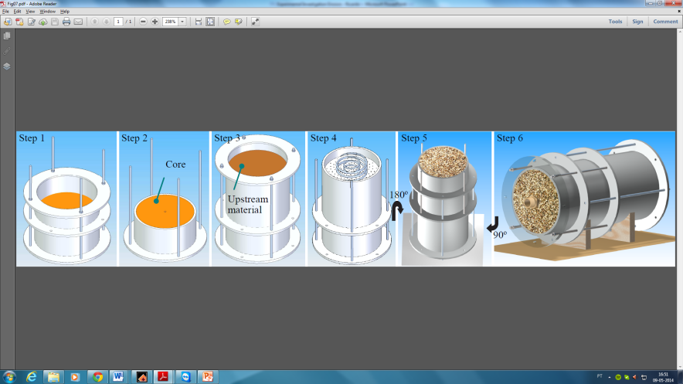
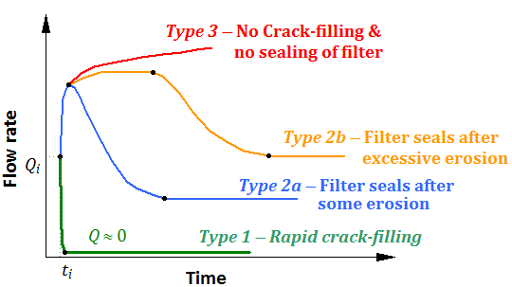
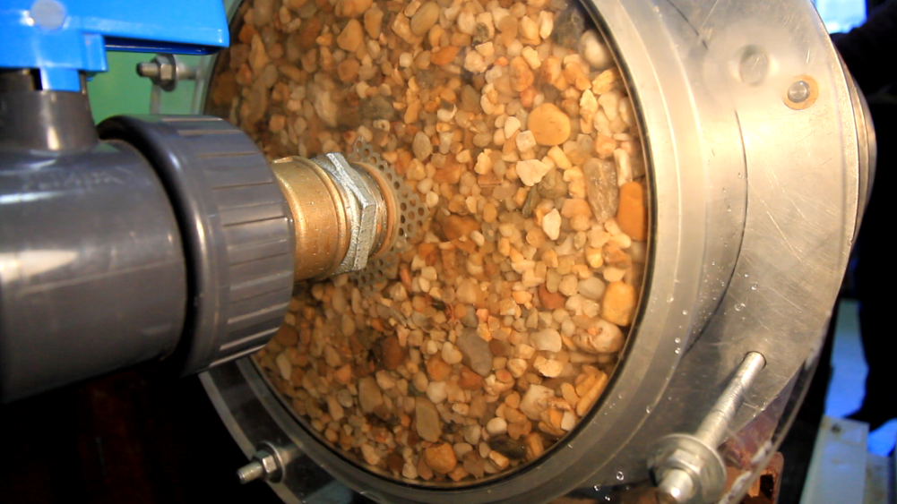
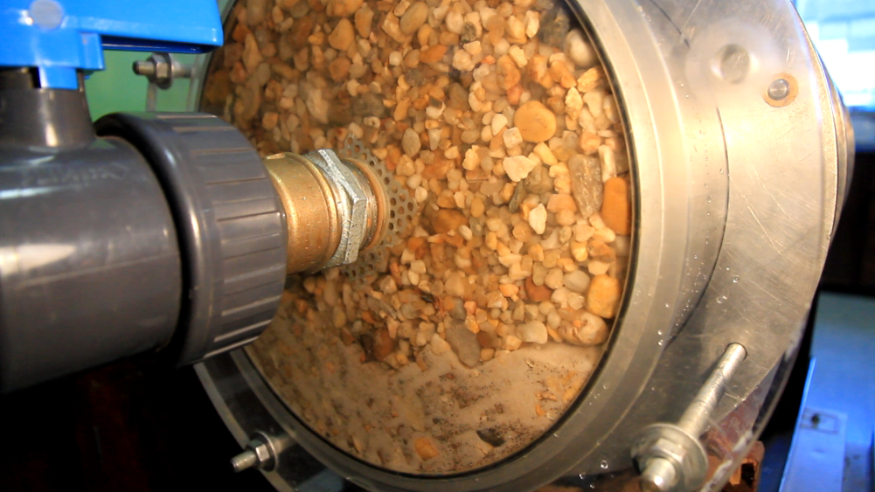
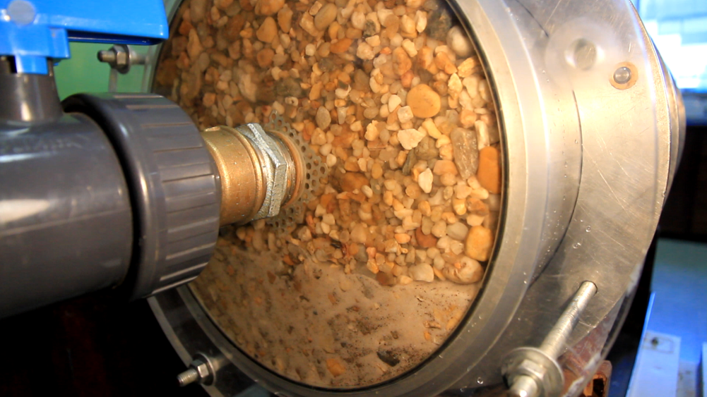
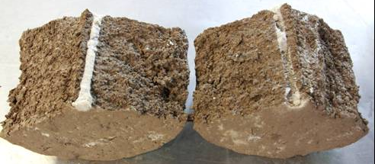
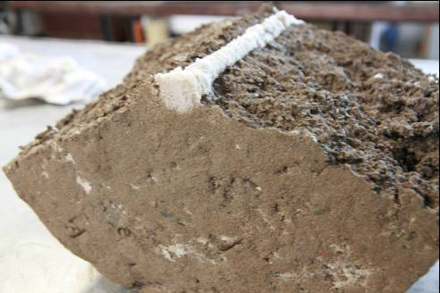
Limitation of the progression of internal erosion in zoned dams: experimental study
Example
Ricardo Correia dos Santos, Postdoctoral researcher, LNEC, Portugal
Objective of study
Testing methodology
What is the Influence of the upstream zone limiting the progression of erosion?
3
.
Crack
Filling
Erosion
Test
Setup
.
Laboratory device
Crack Filling →
Developed test cell
CFET
Downstream filter
Upstream material
FLET
Flow Limiting
Specimen compaction
Allows for two Erosion Tests
Results / Conclusion
Typical results (CFET)
start
+ 5 min
+ 45 min

